Slide 1



Slide 2
About me
Educational Background
Bachelor of Technology (B.Tech)
Specialization: Big Data
Graduation Year: 2025
I've always been a curious person, and I love solving puzzles.
To me, data science feels like the ultimate puzzle.
You get to take a bunch of raw information, find the story hidden inside, and then use that story to help people make smarter decisions.

Slide 3
Experience and linkedin and GitHub URLs
I don't have traditional, full-time work experience, but I completed a three-month internship with IBM in the field of data analysis. During that internship, I worked on a project where I used Python to analyze customer data. I was responsible for cleaning the data, performing exploratory analysis, and creating reports. It was a great opportunity for me to apply the skills I learned in my B.Tech to a real-world business problem
LinkedIn : www.linkedin.com/in/rama-sandeep-gavini-b983b523b
GitHub: https://github.com/ramasandeep-2003

Slide 4
Objective of the project
The objective of the music store data analysis project is to perform a comprehensive analysis of sales and customer data to uncover key business insights.
This includes:
Analyzing Sales Performance: Understanding sales trends over time and identifying top-selling artists and albums.
Understanding Customer Behavior: Pinpointing the best customers, determining regional preferences, and analyzing purchasing patterns.
Providing Actionable Recommendations: Generating data-driven insights to help the business make informed decisions on marketing strategies and customer engagement.

Slide 5
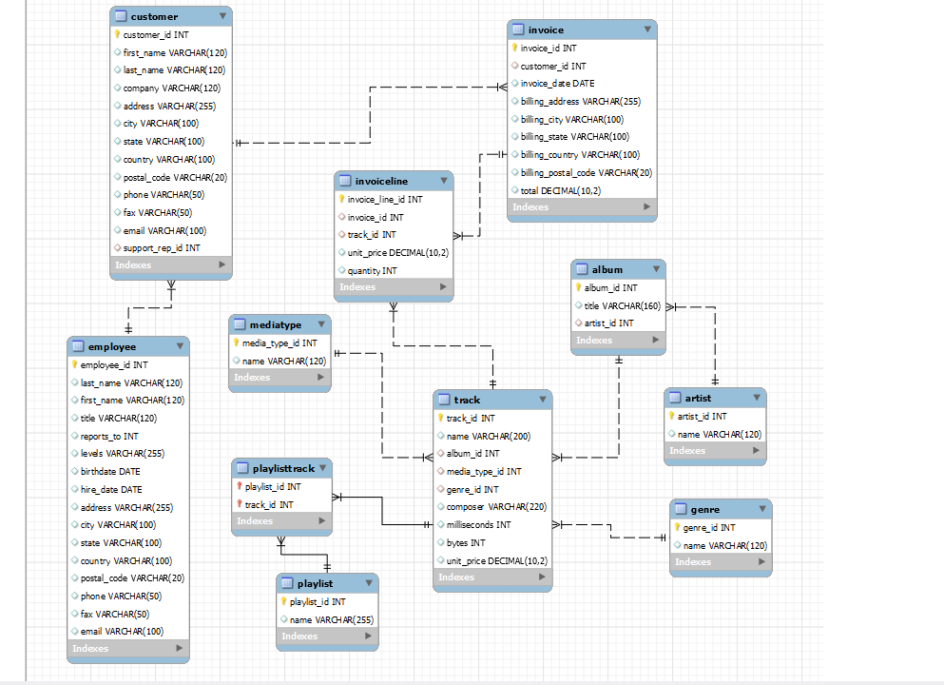
ER Diagram

Slide 6
Schema Explanation
Think of this diagram as the master plan for how a company organizes all its important employee and project information. Instead of putting everything in one big list, the information is split into smaller, linked tables to keep things neat and easy to manage.

Slide 7
Key analysis questions
Sales and Revenue Analysis
What are the total sales for each country?
Which media types (e.g., MPEG, AAC) are the most popular by the number of tracks sold?
How has monthly sales revenue trended over the last two years?
Customer Behavior Analysis
Who are the top 10 customers by total spending?
What is the average number of tracks purchased per invoice?
Do customers from different countries show a preference for specific music genres?

Slide 8
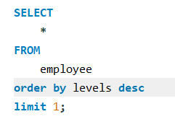
1. Who is the senior most employee based on job title?
Madan mohan is the senior most, employee based on job title

Slide 9
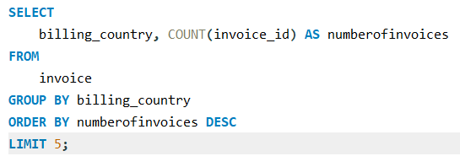
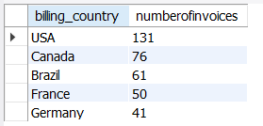
2. Which countries have the most Invoices?
Usa ,Canada,brazil,France,Germany are
the
countries have the most Invoices

Slide 10
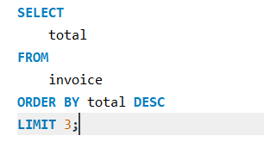
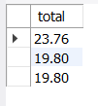
3. What are the top 3 values of total invoice?
The top three values of the invoice totals are $23.76, $19.80, and $19.80.

Slide 11
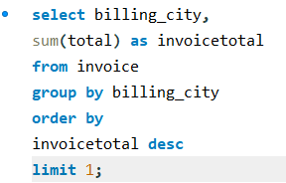

4. Which city has the best customers? - We would like to throw a promotional Music Festival in the city we made the most money. Write a query that returns one city that has the highest sum of invoice totals. Return both the city name & sum of all invoice totals
Prague has the best customer.

Slide 12
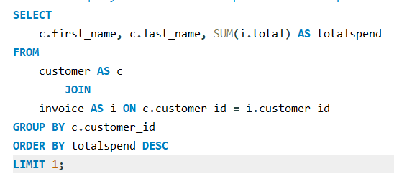

5. ? The customer who has spent the most money will be declared the best customer. Write a query that returns the person who has spent the most money.
The best customer, based on total spending, is František Wichterlová, who has spent a total of $144.54.

Slide 13
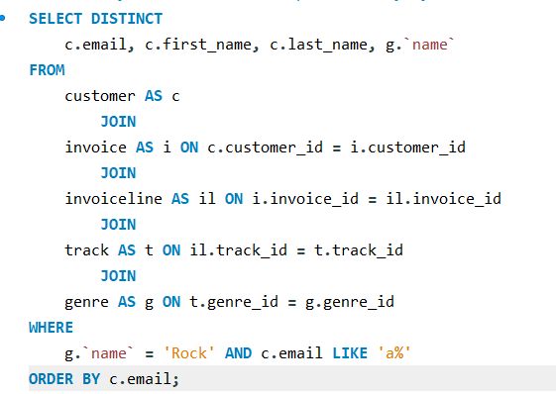
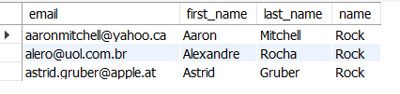
6. Write a query to return the email, first name, last name, & Genre of all Rock Music listeners. -- Return your list ordered alphabetically by email starting with A
Aaron Mitchell, Alexandre Rocha, and Astrid Gruber are rock music listeners whose emails start with 'A'.

Slide 14
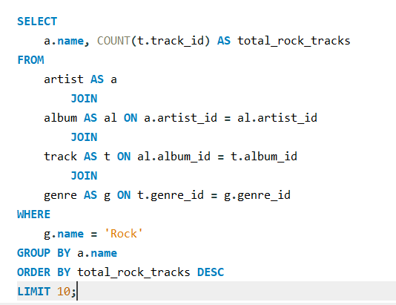
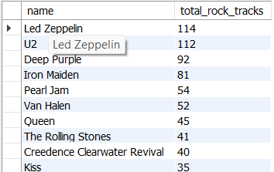
7. Let's invite the artists who have written the most rock music in our dataset.-- Write a query that returns the Artist name and total track count of the top 10 rock bands

Slide 15
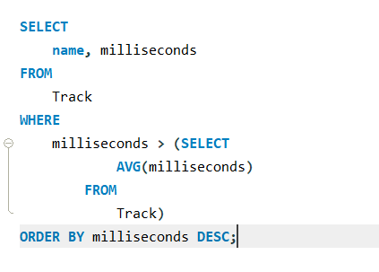
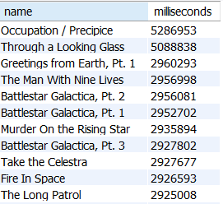
8. Return all the track names that have a song length longer than the average song length.-- Return the Name and Milliseconds for each track. Order by the song length, with the longest songs listed first

Slide 16
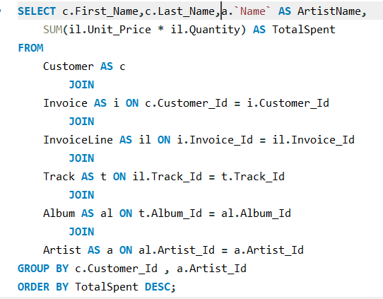
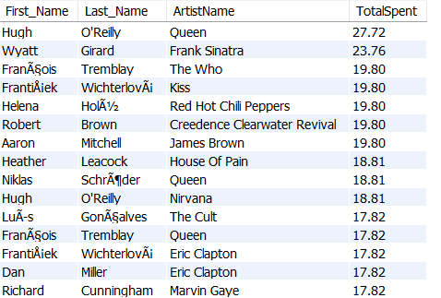
9. Find how much amount is spent by each customer on artists? Write a query to return customer name, artist name and total spent

Slide 17
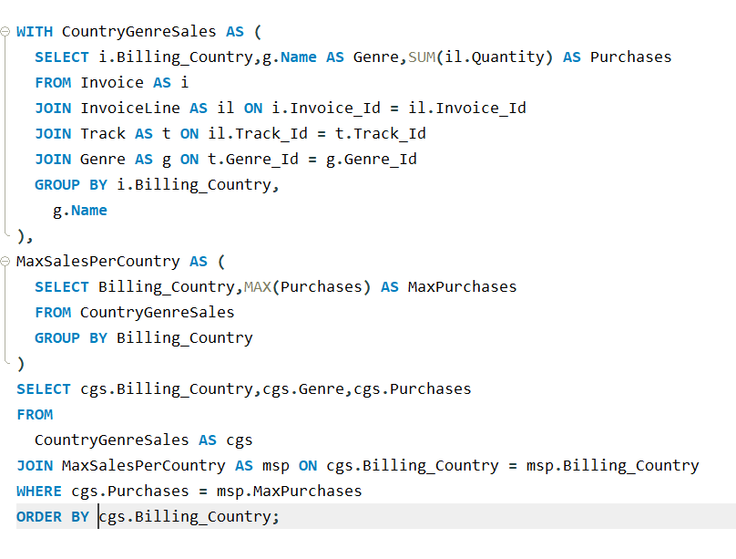
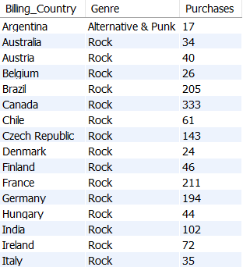
10. We want to find out the most popular music Genre for each country. -- We determine the most popular genre as the genre with the highest amount of purchases. -- Write a query that returns each country along with the top Genre. -- For countries where the maximum number of purchases is shared, return all Genres

Slide 18
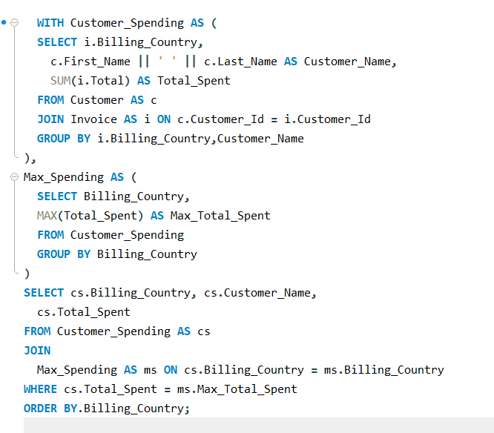
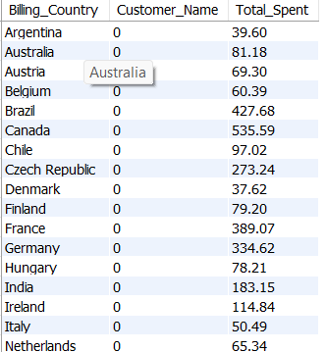
11. Write a query that determines the customer that has spent the most on music for each country. -- Write a query that returns the country along with the top customer and how much they spent. -- For countries where the top amount spent is shared, provide all customers who spent this amount

Slide 19
Final Business Insights & Recommendations
Sales are concentrated: A small number of customers and a single city (Prague)
are responsible for a large portion of the revenue.
Rock music dominates: Rock is the most popular music genre,
with a high number of top-selling artists and tracks.
Top performers exist: There is a clear hierarchy of performance among sales
agents, artists, and customers.

Slide 20
conclusion
The data conclusively shows that the music store's success is driven by a highly concentrated, yet valuable, market. The clear path for growth is to leverage the dominance of the Rock genre and actively engage with top-performing customers and cities to maximize revenue.

Slide 21
Experience
Throughout this project, my experience was focused on tackling a series of real-world data challenges to uncover valuable business insights.
The initial task was to integrate and understand a complex dataset spread across 10 different CSV files. I focused on connecting these separate data sources to build a complete picture of sales, customer behavior, and music content.

Slide 22



